Slide 1
Facility Development Proposals Submission via a new web form
Riko Wichmann
30. July 2019

Slide 2
Submission of Facility Development Proposals
Request beam / facility time during blue weeks
Simple and low-key
Submission can happen any time
Proposals will be reviewed, prioritized and scheduled by members of the Operation Board
Accessible via the “relaunched” http://xfel.desy.de web site
Now reflecting the (accelerator) operation

Slide 3
The new http://xfel.desy.de Web Site

Slide 4
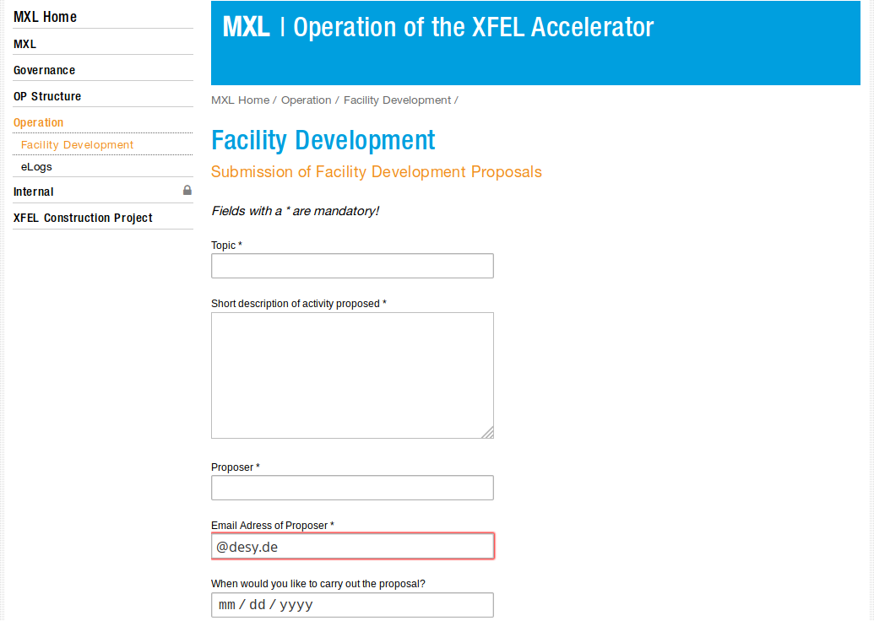
Web Form to Submit Proposal for Blue Weeks https://xfel.desy.de/operation/facility_development/
Mandatory Fields
Topic headline
Short Description
Name of Proposer
Email address if proposer

Slide 5
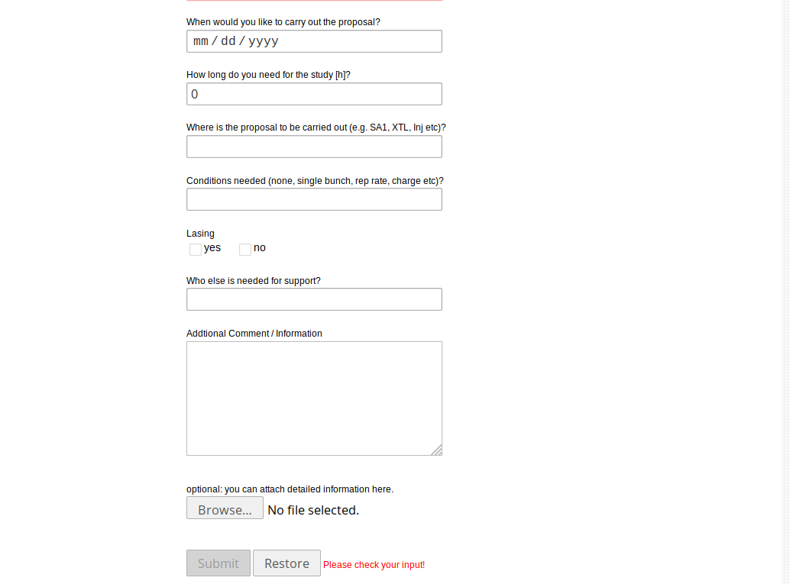
Web Form to Submit Proposal for Blue Weeks https://xfel.desy.de/operation/facility_development/
if you have a full blown proposal or (other) supporting documents you can attach them as well
That’s optional
Submit sends the proposal to
xfel-facility-development@desy.de
Members of the OB
and cc:Requester

Slide 6
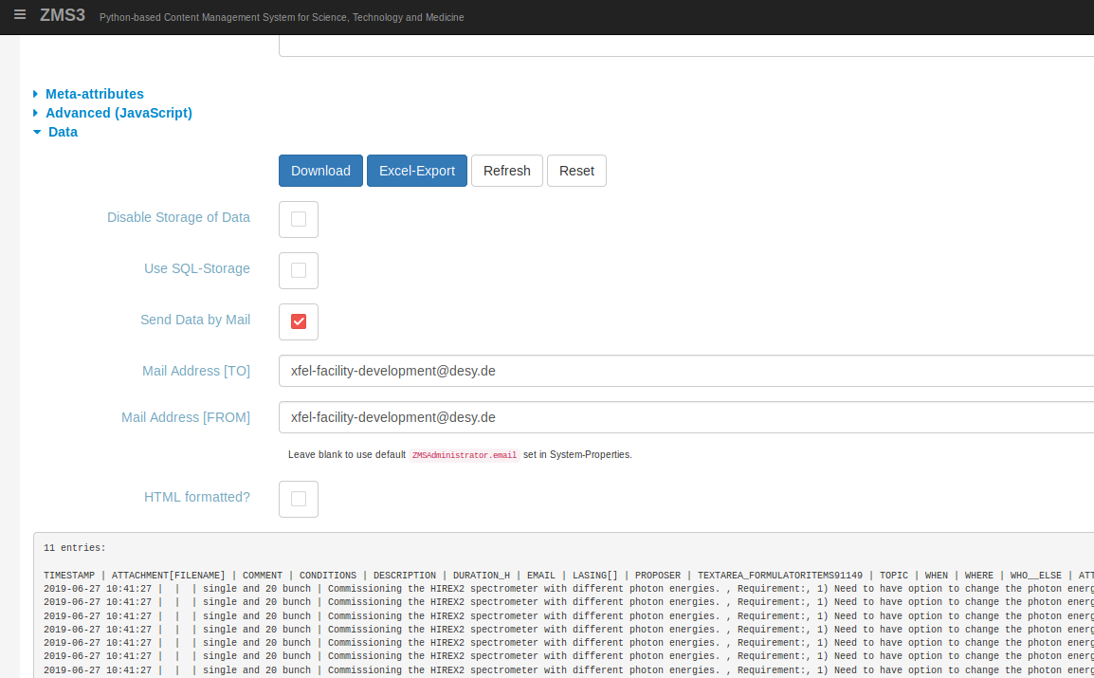
Access, Export and Reset Database of FD Requests (restricted to Admins)
Access the management interface of the FD page
Download as csv
Export to Excel (seems also to be just a csv file)
Reset to empty Database
Login with your usual credentials

Slide 7
Summary
Proposals for activities during blue weeks to be submitted via a web form
https://xfel.desy.de/operation/facility_development/
Web form with mandatory fields:
Topic, Description, Proposer with email address
And optional fields of
Date to carry out the task, duration, location in the facility, condition in particular lasing?, support needed, comments and document
Sends email to xfel-facility-development@desy.de, cc: proposer
proposal list will be composed and published on https://ttfinfo.desy.de/XFELelog

