Slide 1
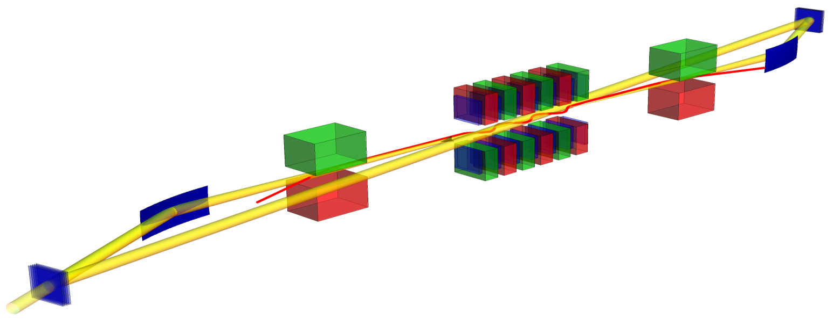
A Hard X-Ray Free-Electron Laser Oscillator at the European XFEL facility
─ electron orbit
─ photons
Diamond Crystals
Bending Magnets
Grazing Incidence Optics
Immo Bahns, Patrick Rauer,
- W. Decking, J. Rossbach, H. Sinn –
Joint RD meeting
supported by BMBF FKZ 05K16GU4

Slide 2
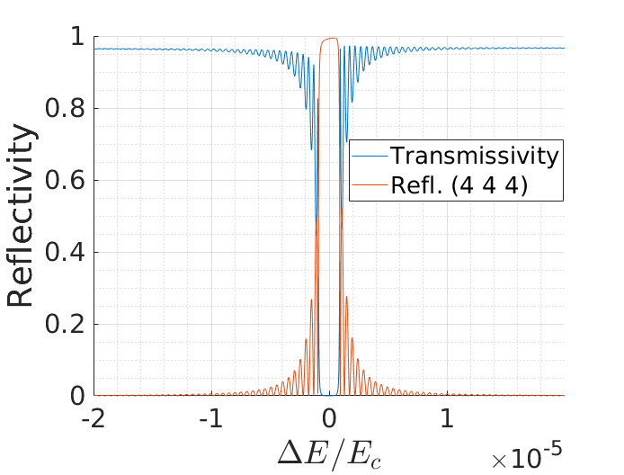
XFELO Basic Concept
Bragg‘s law:
$$nλ=2d∙\sin{θ}$$
X-ray FEL Oscillator:
Suggestion by K.J. Kim 2008: use principle of Bragg reflection
Notes:
FELO → UV to IR optical with high reflectivity based on Fresnel equations are available
XFELO → wavelength in range of atomic distance → reflectivity based on Fresnel equations is very small → X-ray optics: Bragg reflector, Grazing incident mirror, Gratings
Dynamical diffraction theory → Bandwidth of Bragg reflector is finite

Slide 3
XFELO at EuropeanXFEL
XFELO necessities:
-High enough single pass gain to compensate for losses
→Brilliant electron beam (Linac)
Matching between electron bunch repitition and photon pulse round trip rate
F.E. LCLS : el. rep-rate = 120 Hz↔2500 km optical path length
euXFEL: el. rep-rate ~ 2.25 MHz ↔ 66.42m reflector distance
Implement a proof-of-principle XFELO at the end of the SASE1 tunnel (last 4-6 Undulators)
Keep it simple (no fancy outcoupling schemes, no tunability, two(four) thick mirrors, compliant with standard operation)
Project proposal in preperation
Notes:
Was zeichnet einen „Brilliant electron beam“ aus? Warum ist diesbezüglich Linac besser als Speicherring?

Slide 4
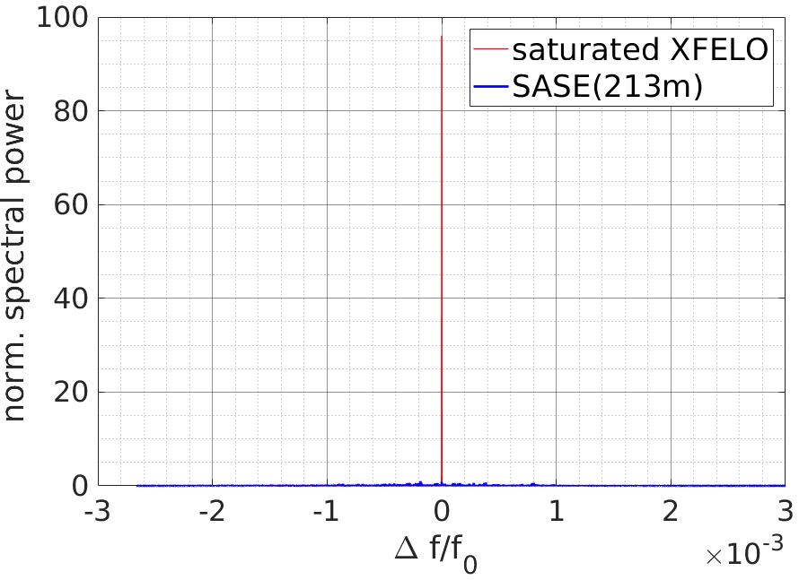
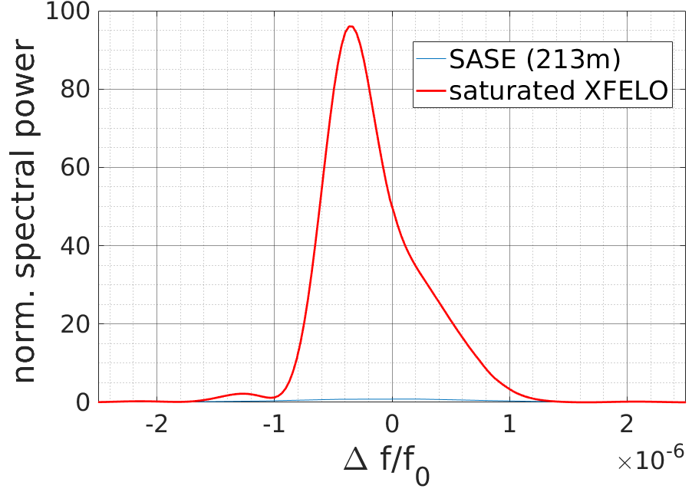
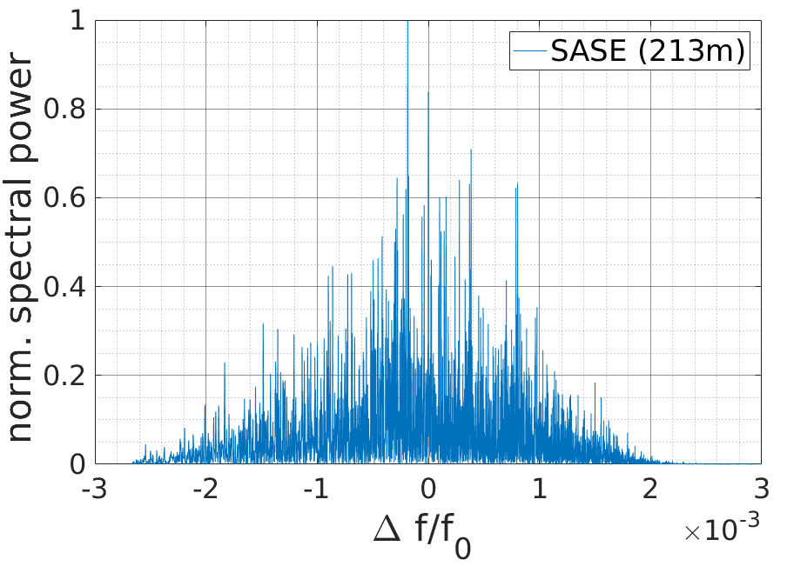
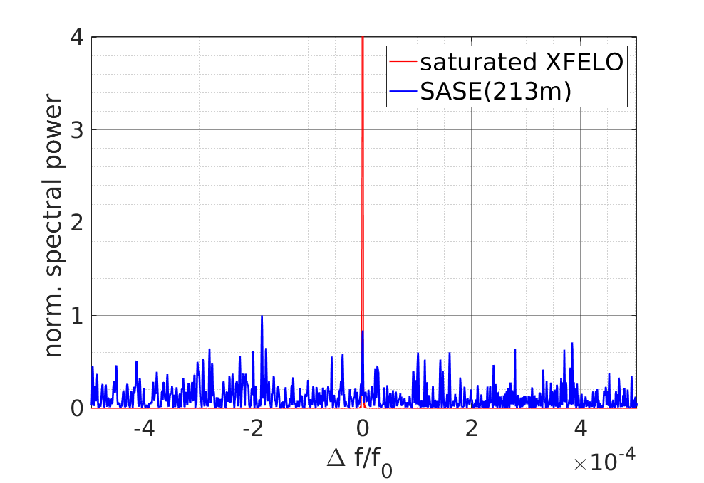
Feasible Parameters
XFELO:
Pulseenergy ~ 2mJ
Pulse lengths of ~ 150fs
Bandwidth $\frac{Δλ}{λ}≈{10}^{−6}\text{−}{10}^{−5}$
Full pulse coherence
Application Energy resolved measurements/ measurements requiring coherence!
[1] G. Geloni et al., N. Jour. Phys., 12, 035021 (2010)
Notes:
SASE (213m) → undulator length 213m?
SASE data simulation or measurement?
High powers SASE → few tens of mJ
High powers XFELO → outcoupling of a few mJ in cavity
-0.2 fs ->multimode interference
-150fs ->fourierlimit pulse duration
Energy resolved measurements → Example: absorption edges, Example for single-frequency X-ray source measurement
Photon puls länger als -> electropuls

Slide 5
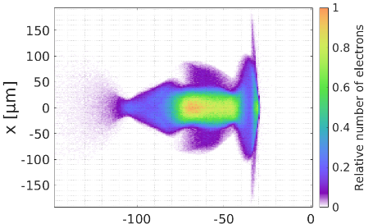
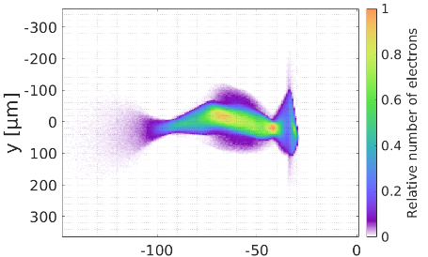
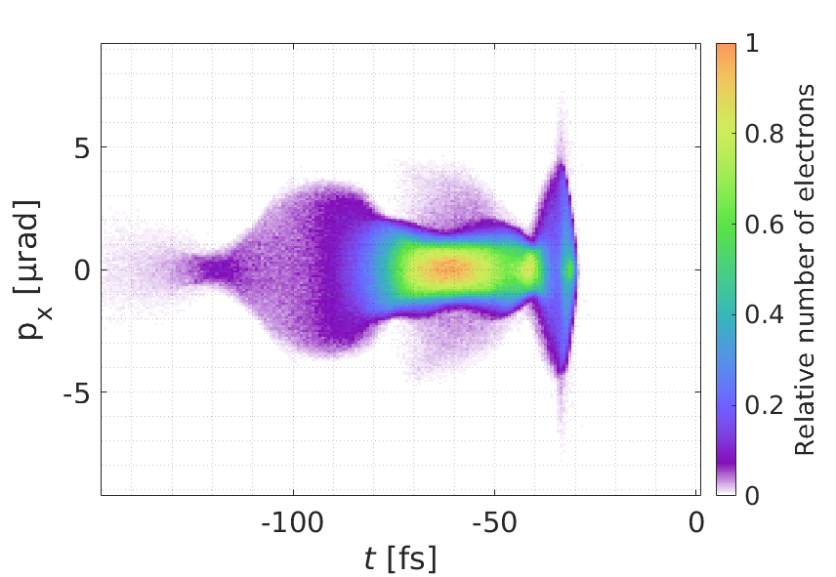
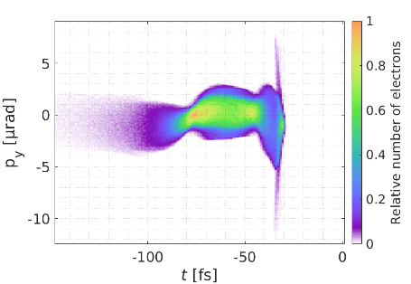
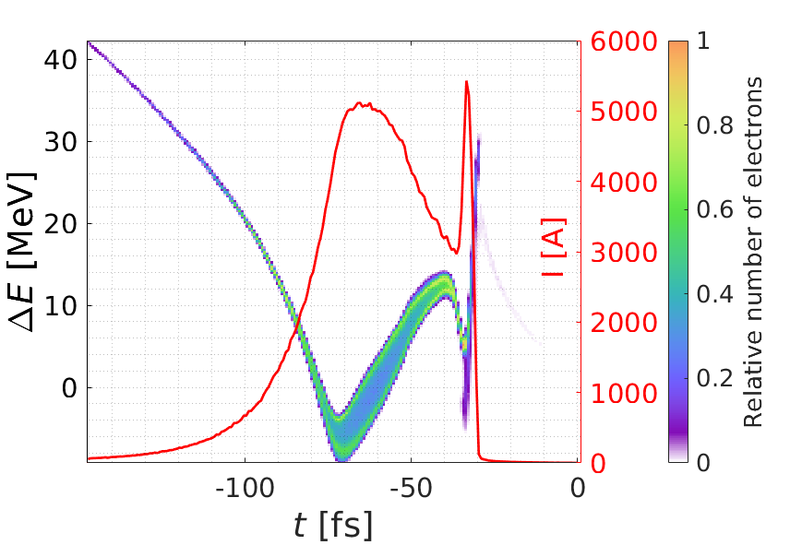
XFELO Plans at SASE1
Implement a proof-of-principle XFELO at the end of the SASE1 tunnel (last 4 Undulators)
Parameters for XFELO setup/Simulation:
electron energy $E_Beam$ = 16GeV
electron repetition-rate $f_Rep^el$=2.25MhZ
mirror to mirror distance $L_(M−M)$=66.42m
mirror material: Diamant
Bragg energies: 6.967 keV (4 0 0 reflex)
Mirror thickness: both $t_C=$150µm
focusing grazing incidence mirror with $f=33.21m$ (in both transverse planes)
Standard electron bunches Q=250pC, rms bunch length = 20 fs, Peak current = 5kA

Slide 6
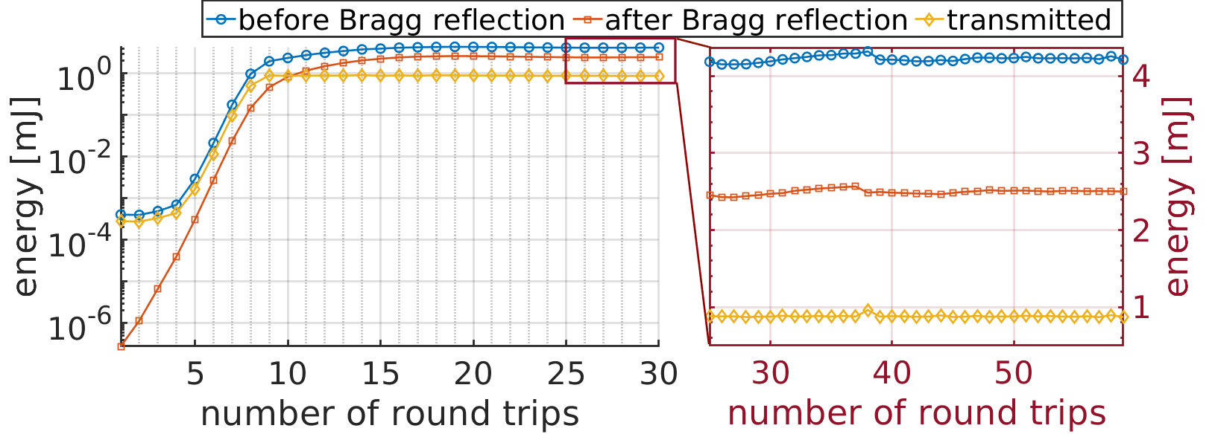
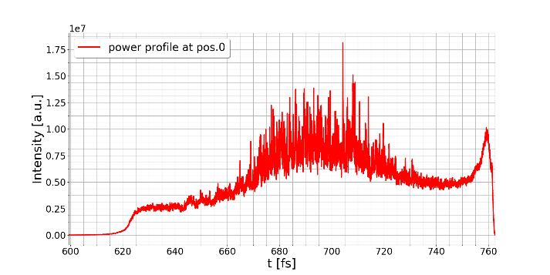
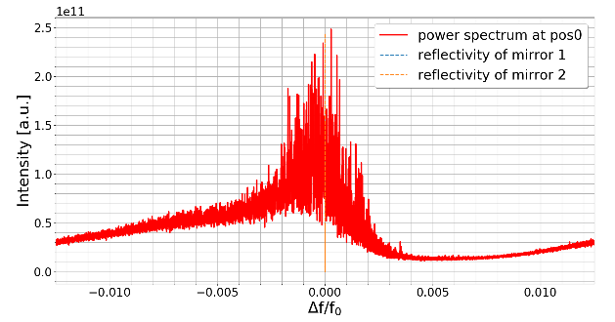
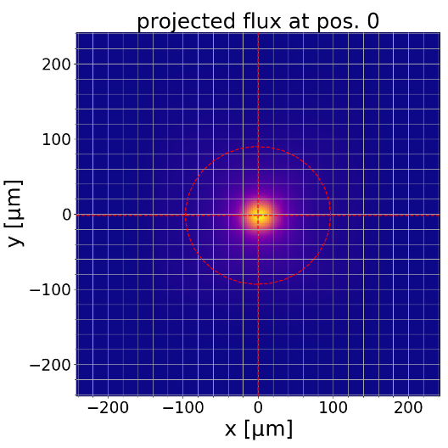
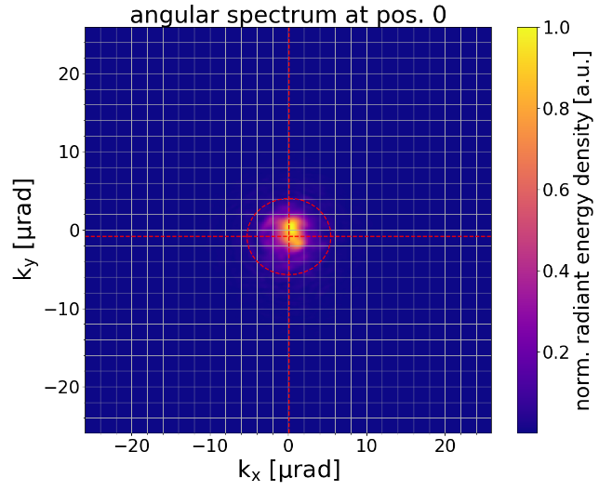
Assuming no errors (and no heat load)
First pass:
strong synchrotron radiation background
thousand of longitudinal modes which in transverse space average to a quasi-gaussian distribution

Slide 7
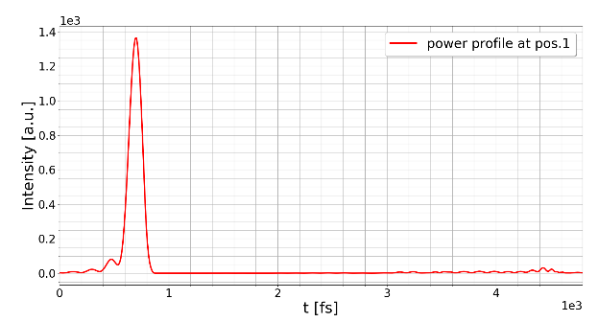
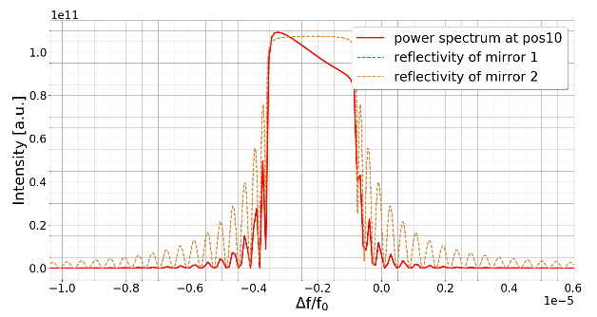
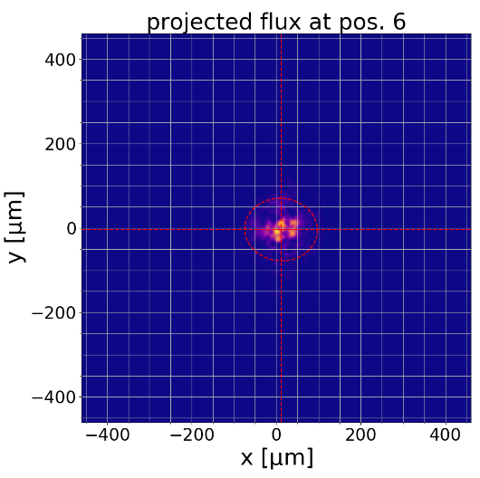
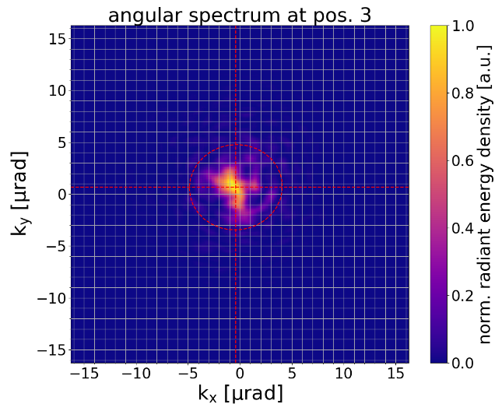
Assuming no errors, no effective aperture (and no heat load)
Only one longitudianal mode refected:
quasi-gaussian transverse properties loss (no averaging of the long. Modes)
radiation profile will then seed the next electron pulse

Slide 8
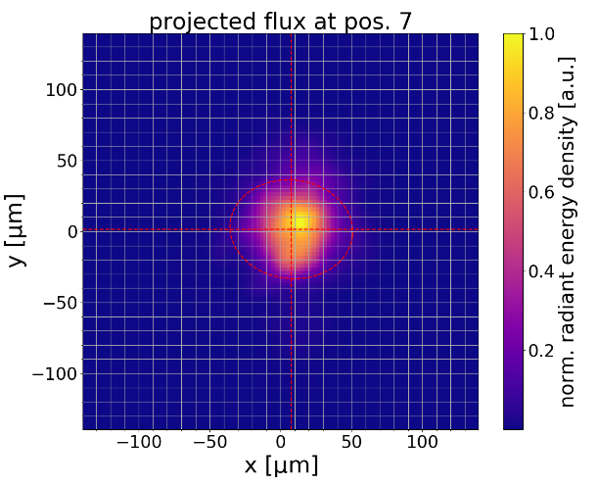
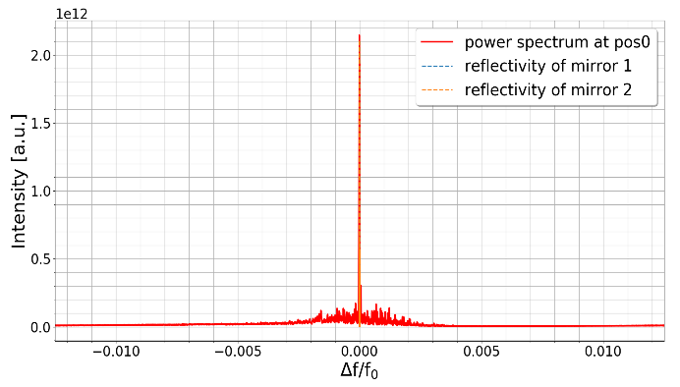
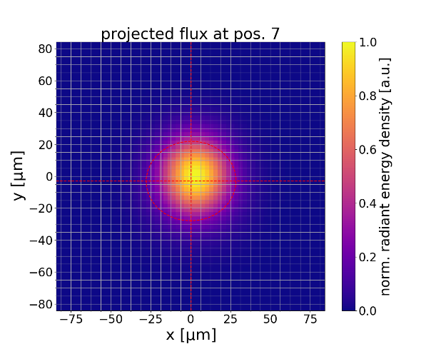
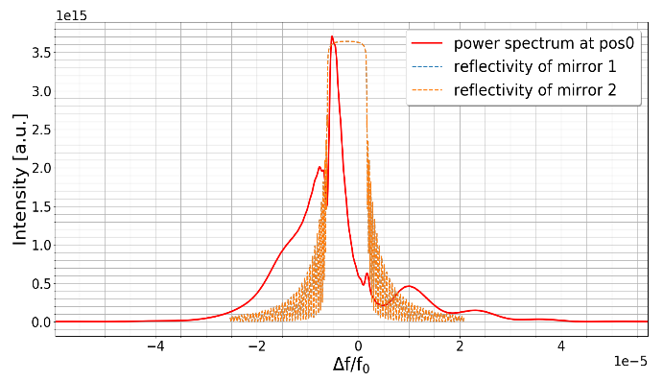
Assuming no errors, no effective aperture (and no heat load)
After three round trips:
a strong seeding close to the Bragg energy
seed dominate over the SASE
Transverse distribution becomes more gaussian like due to the strong gain guiding
After ten round trips:

Slide 9
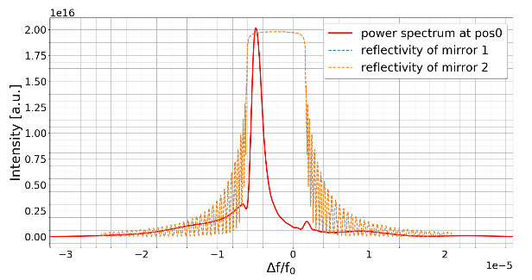
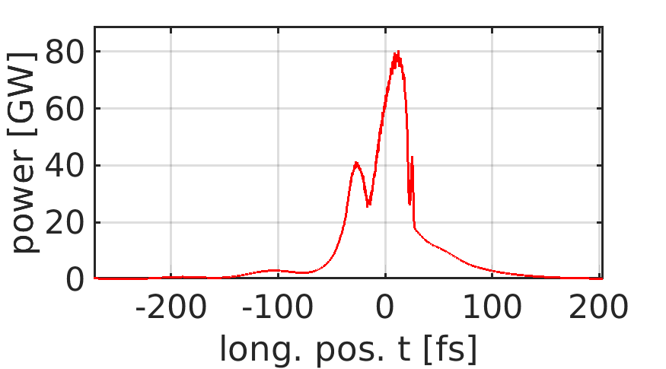
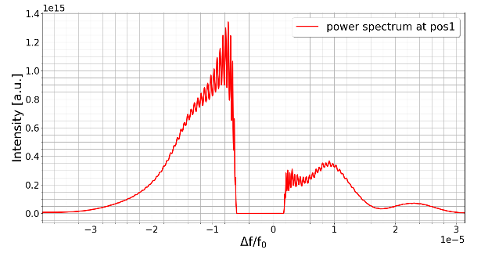
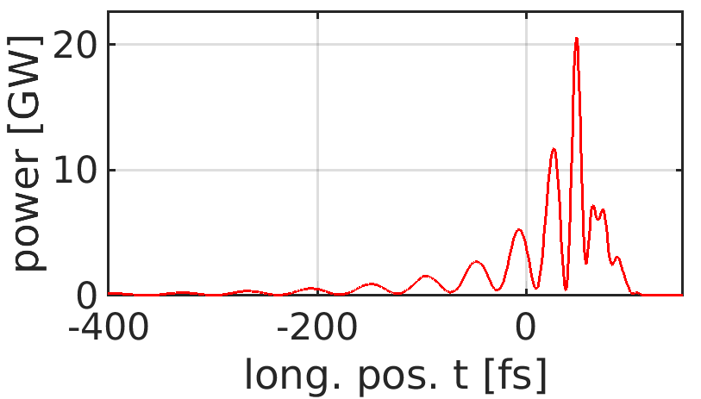
Assuming no errors, no effective aperture (and no heat load)
In cavity after twenty round trips → saturated:
outcoupeled after twenty round trips → saturated:

Slide 10
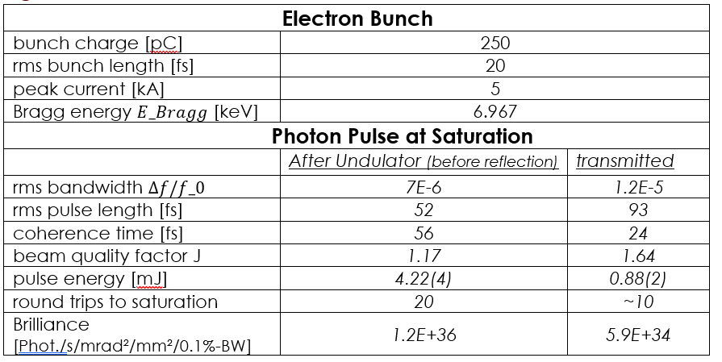
Assuming no errors, no effective aperture (and no heat load)

Slide 11
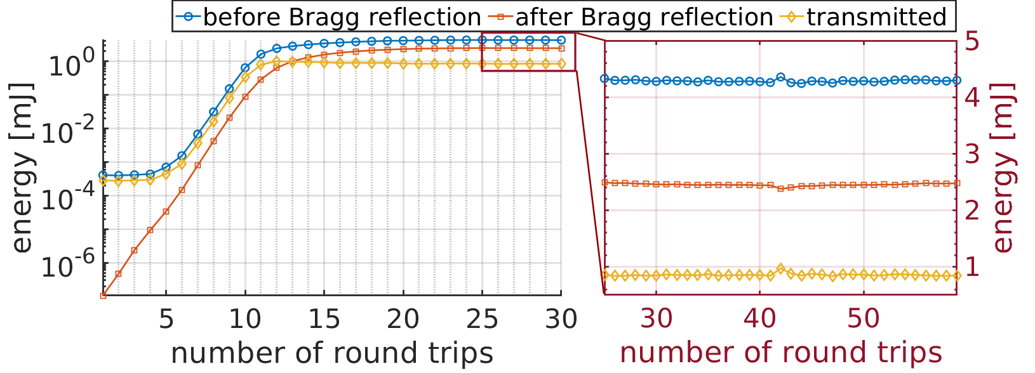
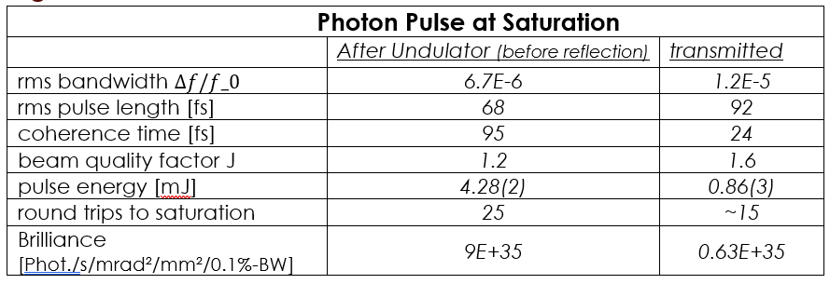
Assuming errors (and no heat load)
Including:
cavity quality factor = 0.95
including a mirror tilt of Θ_r≈100nrad
rms electron pointing jitter = 80nrad
arrival time jitter = 20fs
surprisingly negligible effects
overall energy in saturation is even slightly higher
angular jitter leading to an averaging out of the inherent electron bunch orbital errors
No errors

Slide 12
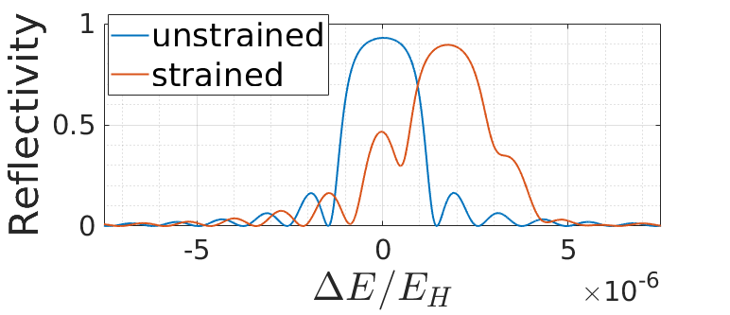
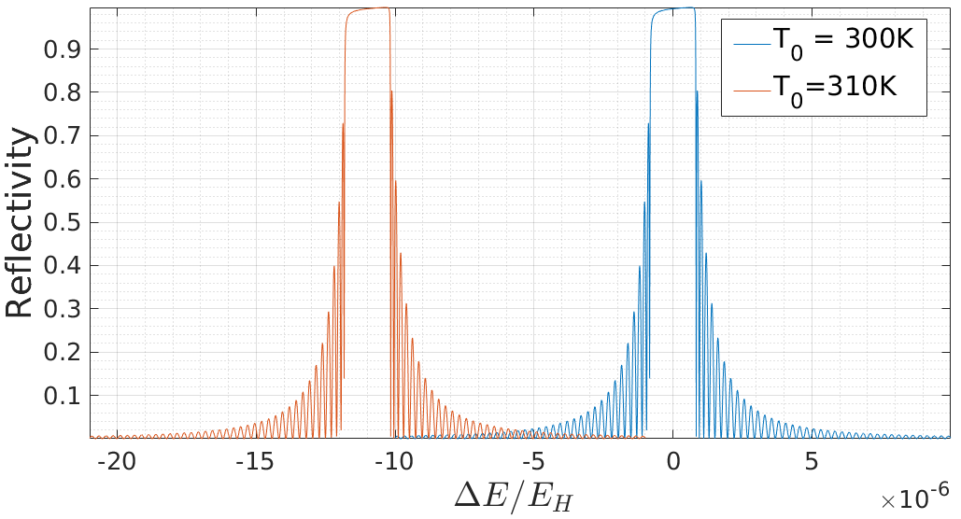
XFELO → Heatload Issues
Saturated XFELO → 4mJ at >1MHz rep.rate on crystal
Disturbing optical stability ← (long term) vibrations
Disturbing crystal spectral reflectivity
Dynamics Answer Of Crystal Towards Rapid Expansion → Strain Waves (Ultrasonics):
Thermal expansion of the lattice in the region of interest:
mJ pulse
$nλ_{H}=2d_{H}\left(T\right)∙\sin{θ}$
Bragg-reflector
Influence unknown todate → checked by simulation as well as by experiment
→ Not yet implemented
Implemented in Simulations → results on the next sheets

Slide 13
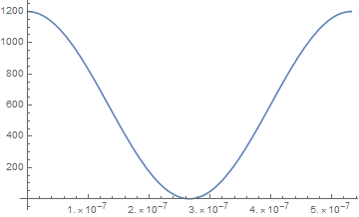
Interaction of Electromagnetic radiation with Bragg reflectors
Michelson Interferometer:
Problem: “Simple” Fourier-Law (infinite speed of heat propagation) will fail at low temperatures
Challenging Part:
Find proper theoretical-model for Thermoelectricity simulation and solve it: Fourier-Law, Cattaneo-equation, Boltzmann transport equation
Solving analytical or Numerical:
FEM, FVM, Monte-Carlo
Pump-Probe Measurments:
Beanchmark for Simulation → Find a theoretical-model that is accurate and fast to solve
Photodiode (risetime<175ps) measures intensity →proportional to|E|² of the probe CW laser (532nm)
For a maximum effect of interference the same polarization is needed and equal intensities
Stabilization of working (WP) point with PID controller
Displacement << ¼ λ signal (intensity) is proportional to displacement
Averaging over thousands of pulses
Resolution <0.5 pm
$$I_{mess}\sim 1+cos(4π ∆z/λ)$$
I_{mess} [mV]
WP
Δz
0 λ/4 λ/2

Slide 14
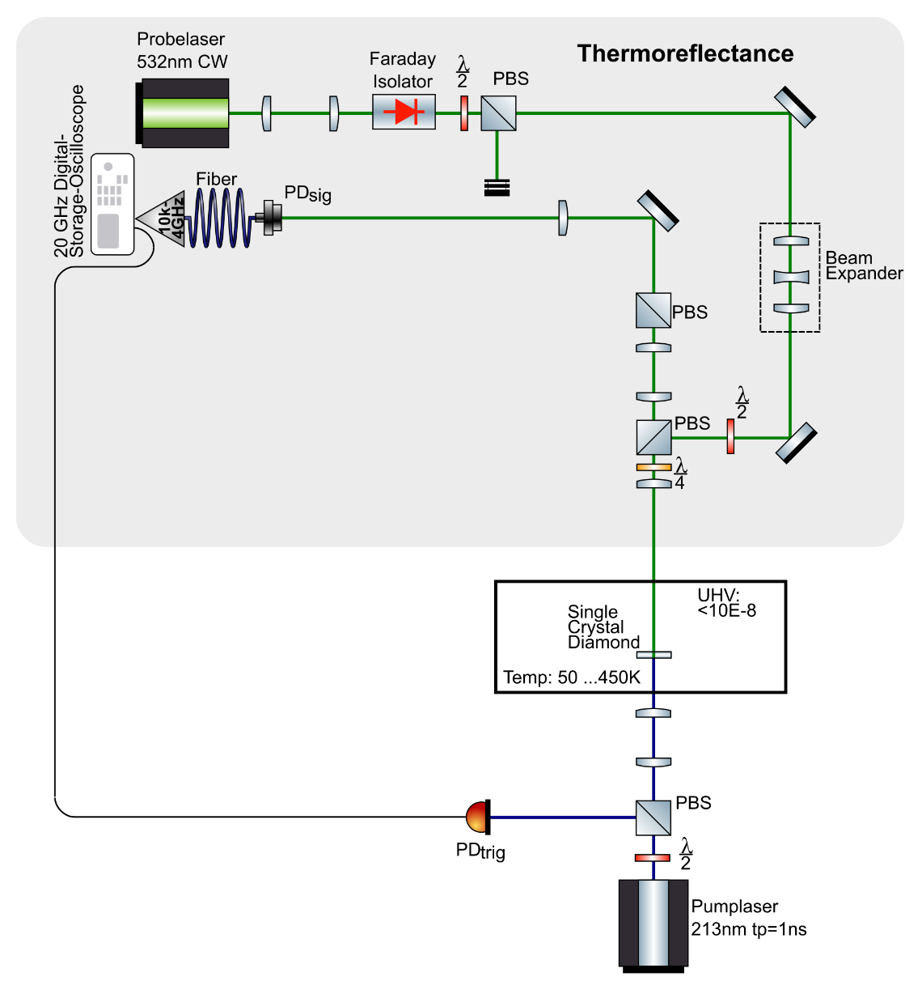
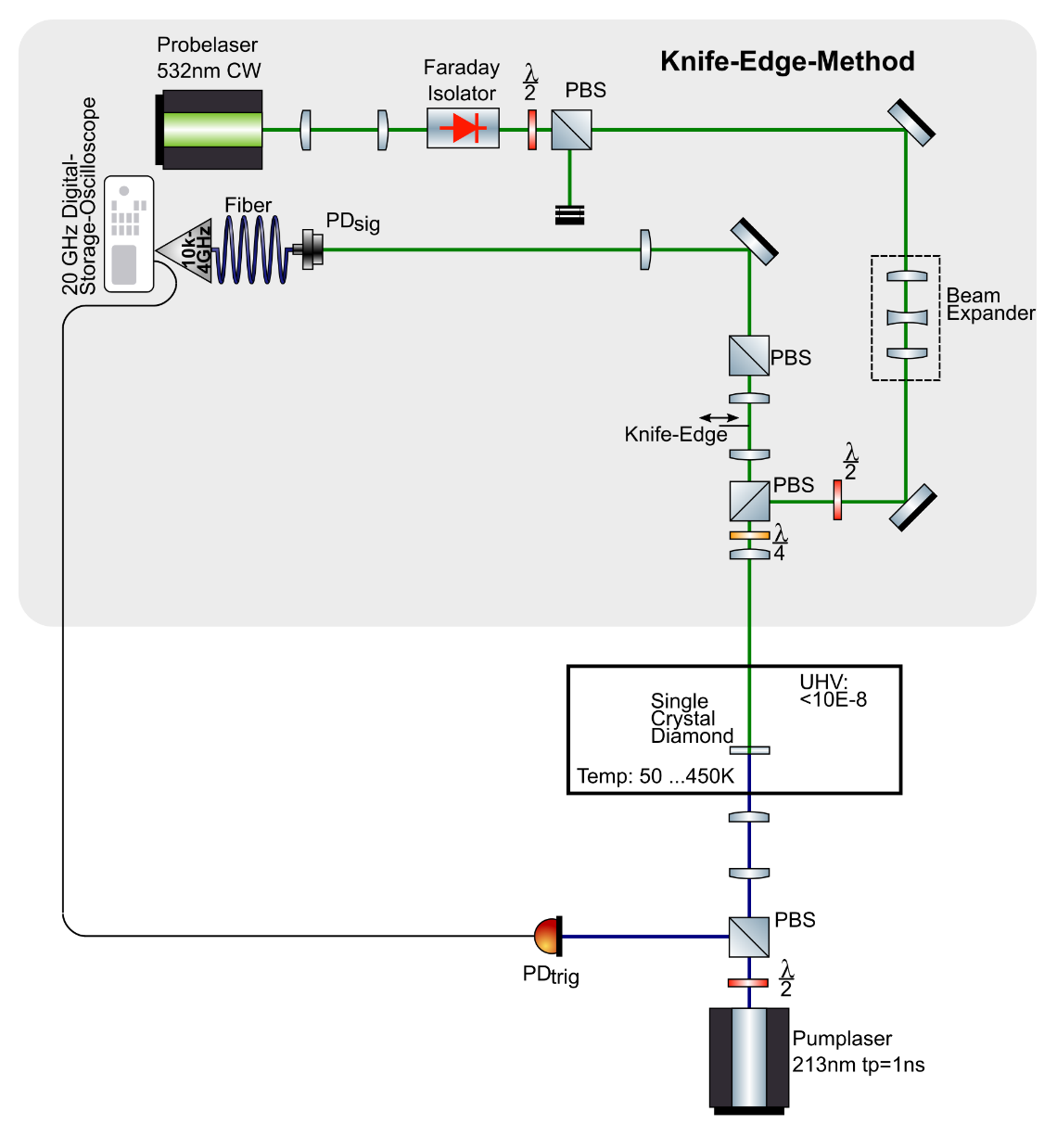
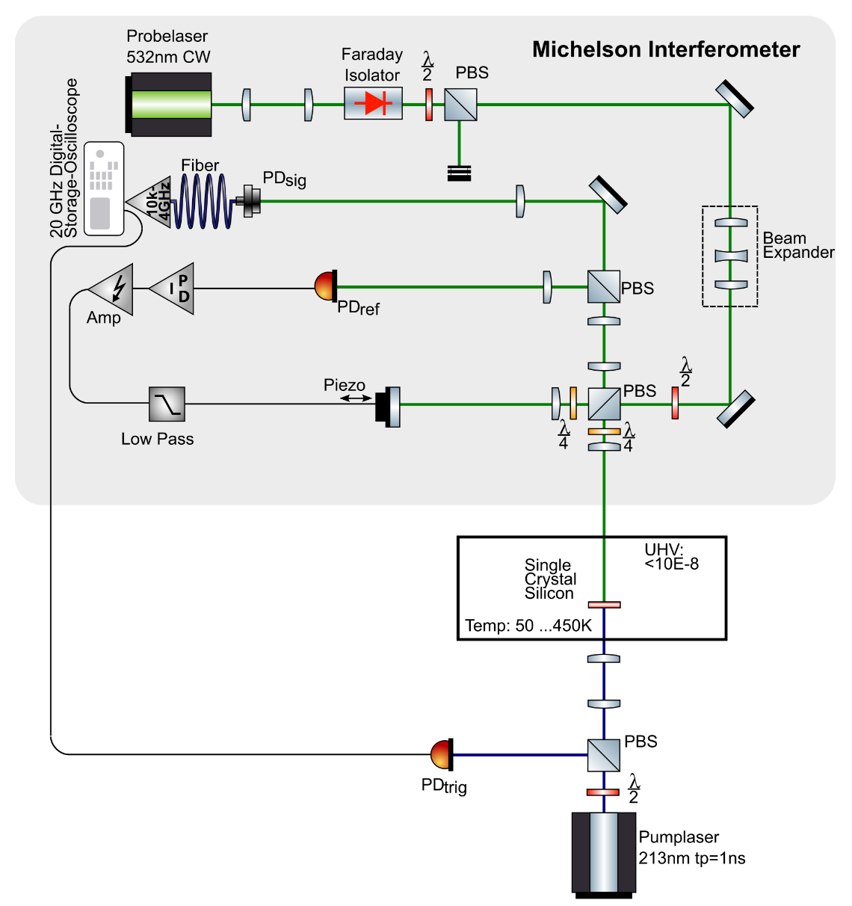
Interaction of Electromagnetic radiation with Bragg reflectors
Experimental Setup:
Pump-Probe measurements
Pump: Pulsed UV Laser → similar heat load like saturated XFELO radiation
Probe: CW-Laser + Ultrafast Photodiods (GHz)
Methods:
Michelson-Interferometer → Displacement
Thermoreflectance → Measuring transient change of reflectance → refractive index (susceptibility)
Knife-Edge-Method → Measuring angular changes →surface waves
I_{mess} [mV]
WP
Δz
0 λ/4 λ/2
Technical Problems:
Vacuum level <10E-8
high frequency signals

Slide 15
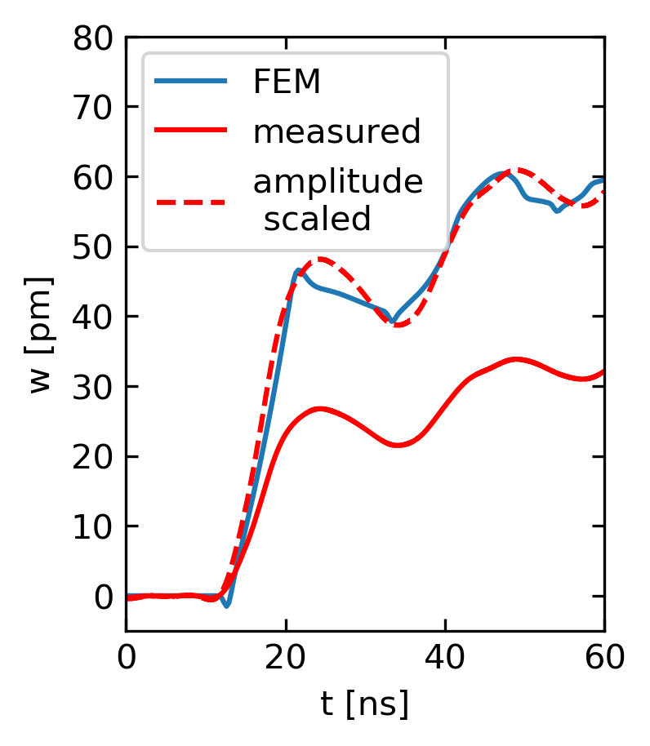
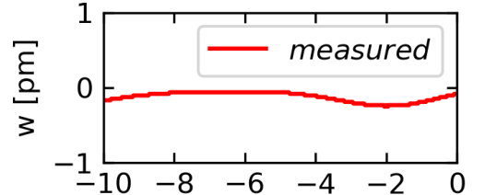
Interaction of Electromagnetic radiation with Bragg reflectors
First Results:
$$I_{mess}\sim 1+cos(4π ∆z/λ)$$
I_{mess} [mV]
WP
Δz
0 λ/4 λ/2
→Resolution
<0.5 pm

Slide 16
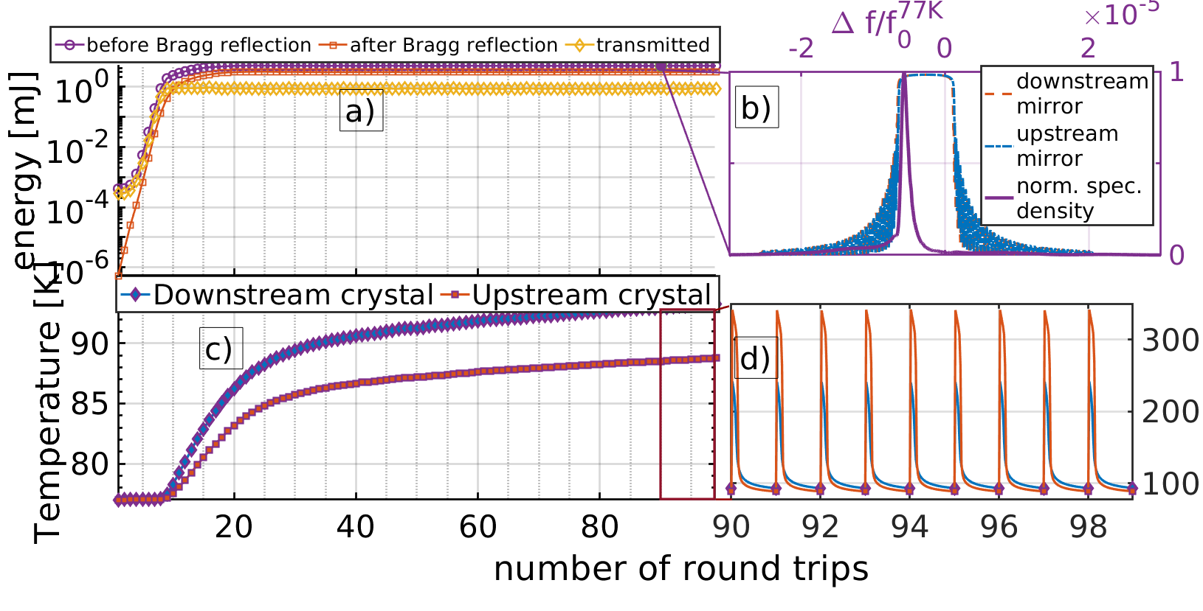
XFELO + Heat Load (no dynamical strain)
Same conditions as before but crystals cooled down to 77K (nitrogen cooling)
Heat simulation → radial symmetric FEM Simulation after each photon pulse
Take the averaged temperature after 440ns (next pulse arrives)→ input for shift of refection curve
High thermal diffusion at 77K for diamond → homogeneous temperature after 400ns
Stable operation → if heat transfer to holder is sufficient and theoretical model valid

Slide 17
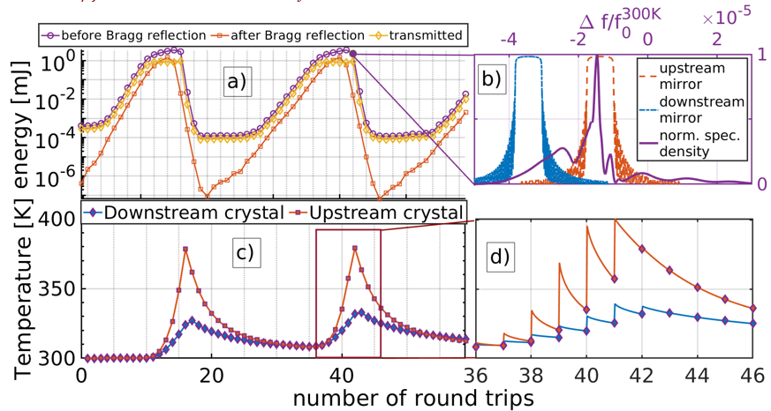
XFELO + Heat Load (no dynamical strain)
Quick and dirty simulation for heat load at room temperature → Same procedure as before
averaged temperature after 440ns (next pulse arrives)→ input for shift of refection curve → homogeneous temperature after 400ns → not true for room temperature thermal diffusion
XFELO still seeds but no stable saturation
Different spot size on crystal → different shift of the reflectivity curves
gap between ref. curves to big → not seed → crystal cools → gap decreases → seed starts again

Slide 18
Conclusion
European XFEL ideal source for implementing an XFELO
Problems:
Heatload ← Stability at saturation
Need to try it out → Proof of principle experiment
Thank you for listening

